Slide 1
Introduction to Python
Kiran Kumar A

Slide 2
Why Programming?
Computers are built for one purpose - to do things for us
But we need to speak their language to describe what we want done
Users have it easy - someone already put many different programs (instructions) into the computer and users just pick the ones we want to use

Slide 3
Users vs. Programmers
Users see computers as a set of tools - word processor, spreadsheet, map, todo list, etc.
Programmers learn the computer “ways” and the computer language
Programmers have some tools that allow them to build new tools
Programmers sometimes write tools for lots of users and sometimes programmers write little “helpers” for themselves to automate a task

Slide 4
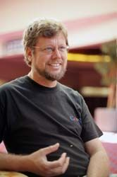
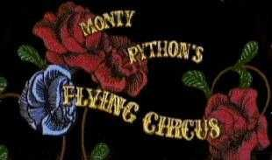
Python
Python is the language of the Python Interpreter and those who can converse with it. An individual who can speak Python is known as a Pythonista. It is a very uncommon skill, and may be hereditary. Nearly all known Pythonistas use software initially developed by Guido van Rossum.

Slide 5
Why python?
Software Quality
Readability => Reusable, Maintainable
Object-oriented (OO)
Functional
Developer Productivity
Dynamic Types
Code Size: 1/3 to 1/5 of C++ or Java code.
Short Code => Less to type, debug, maintain

Slide 6
Program portability
Same program runs on windows, linux and mac
Support libraries
Standard library
text pattern matching to network scripting
Third-party
+ Website construction
+ Numeric programming
+ Serial port access
+ Game development
+ (e.g.) NumPy is better than Matlab

Slide 7
Component Integration
Can invoke C and C++ libraries
Can be called from C and C++
Can integrate with Java and .NET, COM and Silverlight,
Can interface with devices over serial ports
Interact over networks with interfaces like SOAP, XML-RPC, and CORBA.
Is Python Scripting language?
Yes, general-purpose programming language that blends procedural, functional, and object-oriented paradigms.

Slide 8
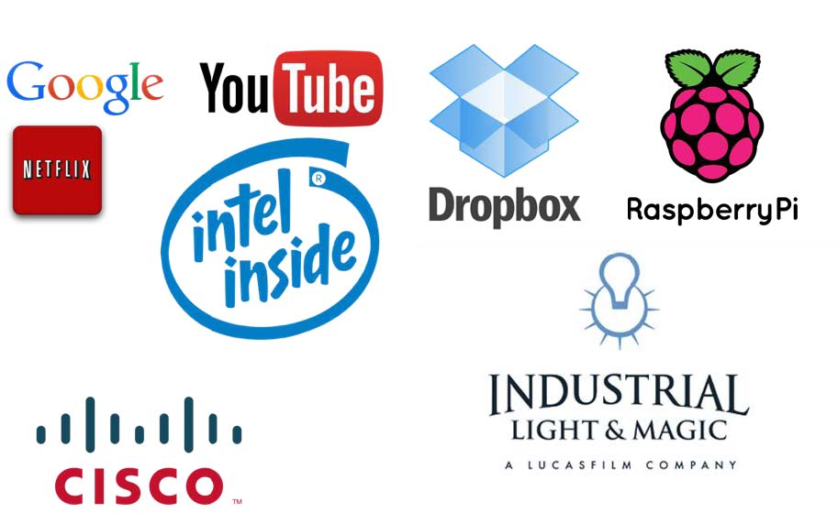
Python Use

Slide 9
What can I do with Python?
System Programming
GUIs
Internet Scripting
Component Integration
Database Programming
Rapid Prototyping
Numeric and Scientific Programming
And More: Gaming, Images, Data Mining, Robots, Excel..etc.

Slide 10
Elements of Python
Vocabulary / Words - Variables and Reserved words
Sentence structure - valid syntax patterns
Story structure - constructing a program for a purpose

Slide 11
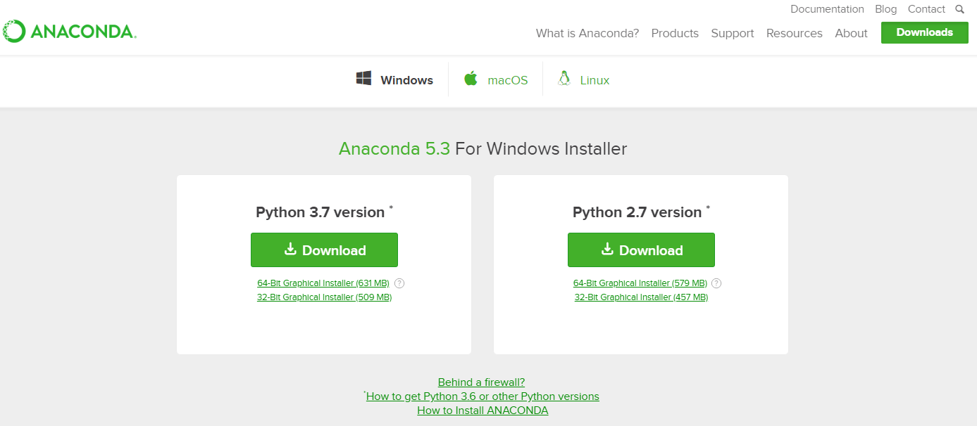
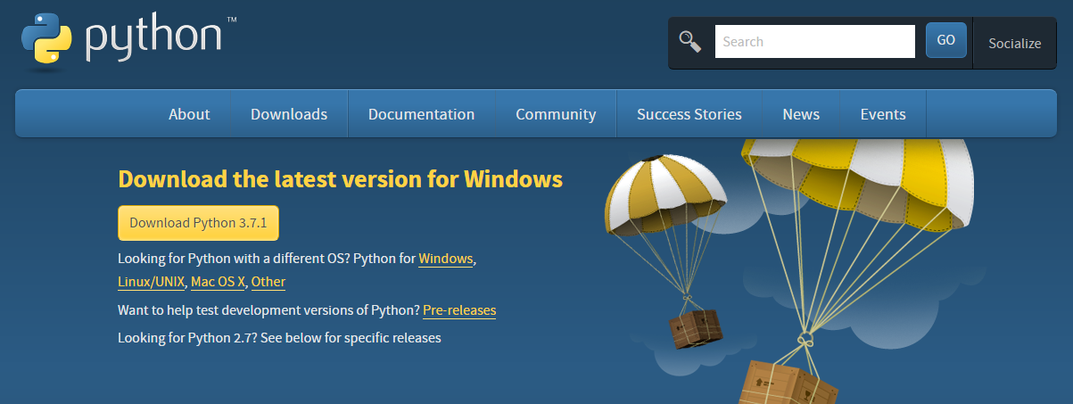
Installations
https://www.python.org/
https://www.anaconda.com/

Slide 12
Modules
Modules in Python are simply Python files with the .py extension, which implement a set of functions. Modules are imported from other modules using the import command.
To import a module, we use the import command. Check out the full list of built-in modules in the Python standard library (https://docs.python.org/3/py-modindex.html).
The first time a module is loaded into a running Python script, it is initialized by executing the code in the module once. If another module in your code imports the same module again, it will not be loaded twice but once only - so local variables inside the module act as a "singleton" - they are initialized only once.
If we want to import the math module, we simply import the name of the module:
import math

Slide 13
Packages
Packages are name-spaces which contain multiple packages and modules themselves. They are simply directories, but with a twist.
Each package in Python is a directory which MUST contain a special file called __init__.py. This file can be empty, and it indicates that the directory it contains is a Python package, so it can be imported the same way a module can be imported.
If we create a directory called foo, which marks the package name, we can then create a module inside that package called bar. We also must not forget to add the __init__.py file inside the foo directory.
To use the module bar, we can import it in two ways:
import foo.bar
from foo import bar

Slide 14
Packages Installations

